Slide 1
Dynamic Memory Allocation

Slide 2
One Dimensional Dynamic Memory
#define SIZE1 25
#define SIZE2 36
int *p; long double *q;
p = (int *)malloc(SIZE1 * sizeof(int));
q = (long double *)malloc(SIZE2 * sizeof(long double));

Slide 3
The first call of malloc allocates to p a (dynamic) array capable of storing SIZE1 integers.
The second call allocates an array of SIZE2 long double data to the pointer q.

Slide 4
Two Dimensional Dynamic Memory
#define ROWSIZE 100
#define COLSIZE 200
int A[ROWSIZE][COLSIZE];
int (*B)[COLSIZE];
int *C[ROWSIZE];
int **D;

Slide 5
Declaration A
The first array A is fully static. It cannot be allocated or deallocated memory dynamically. As the definition of A is encountered, the required amount of space is allocated to A from the stack area of the memory.

Slide 6
Declaration B
B is a pointer to an array of COLSIZE integers. So it can be allocated ROWSIZE rows in the following way:
B = (int (*)[COLSIZE])malloc(ROWSIZE * sizeof(int[COLSIZE]));

Slide 7
Declaration C
C is a static array of ROWSIZE int pointers. Therefore, C itself cannot be allocated or deallocated memory. The individual rows of C should be allocated memory.
int i;
for (i=0; i<ROWSIZE; ++i)
C[i] = (int *)malloc(COLSIZE * sizeof(int));

Slide 8
Declaration D
D is dynamic in both directions. First, it should be allocated memory to store ROWSIZE int pointers each meant for a row of the 2-D array. Each row pointer, in turn, should be allocated memory for COLSIZE int data.
int i;
D = (int **)malloc(ROWSIZE * sizeof(int *));
for (i=0; i<ROWSIZE; ++i)
D[i] = (int *)malloc(COLSIZE * sizeof(int));
The last two pointers C,D allow rows of different sizes, since each row is allocated memory individually.

Slide 9
Analysis of Algorithms
How much resource is required ?
Measures for efficiency
  Execution time → time complexity
  Memory space → space complexity
Observation :
  The larger amount of input data an algorithm has, the larger amount of resource it requires.
    Complexities are functions of the amount of input data (input size).

Slide 10
What do we use for a yardstick?
The same algorithm will run at different speeds and will require different amounts of space when run on different computers, different programming languages, different compilers.
But algorithms usually consume resources in some fashion that depends on the size of the problem they solve : n.

Slide 11
Sorting integers
void sort (int A[], int N)
{
int i, j, x;
for (i=1; i<N; i++)
{
x = A[i];
for (j=i; j>0 && x<A[j-1]; j- -)
A[j] = A[j-1];
A[j] = x;
}
}

Slide 12
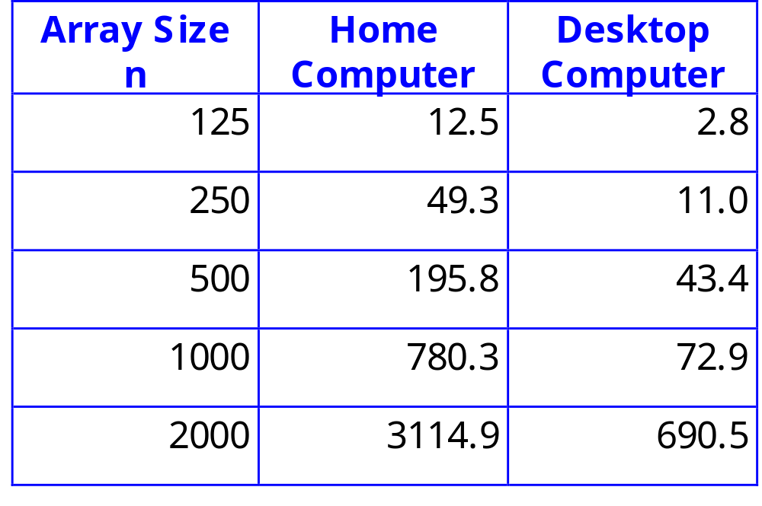
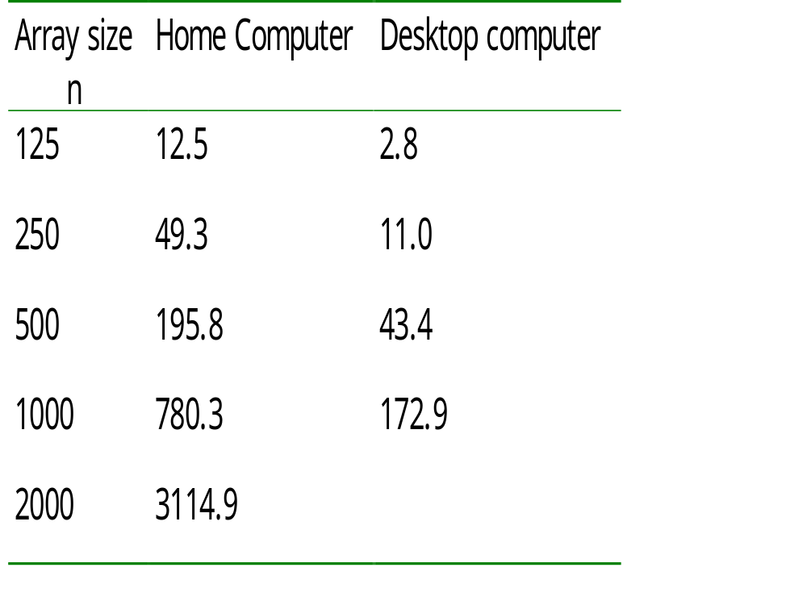
We run this sorting algorithm on two different computers, and note the time (in ms) for different sizes of input.

Slide 13
Contd.
Home Computer :
  f₁(n) = 0.0007772 n² + 0.00305 n + 0.001
Desktop Computer :
  f₂(n) = 0.0001724 n² + 0.00040 n + 0.100
  Both are quadratic function of n.
  The shape of the curve that expresses the running time as a function of the problem size stays the same.

Slide 14
Complexity classes
The running time for different algorithms fall into different complexity classes.
  Each complexity class is characterized by a different family of curves.
  All curves in a given complexity class share the same basic shape.
The O-notation is used for talking about the complexity classes of algorithms.

Slide 15
Introducing the language of O-notation
For the quadratic function
f(n) = an² + bn + c
we will say that f(n) is O(n²).
  We focus on the dominant term, and ignore the lesser terms; then throw away the coefficient.

Slide 16
Mathematical background
T(N) = O(f(N)) if there are positive constants c and n₀ such that T(N) ≤ c f(N) when N ≥ n₀.
Meaning : As N increases, T(N) grows no faster than f(N).
The function T is eventually bounded by some multiple of f(N). f(N) gives an upper bound in the behavior of T(N).

Slide 17
Examples
log_{e}n = O(n)
n¹⁰ = o(2^{n})
3 n² + 5n + 1 = θ(n²)

Slide 18
Concepts in Analysis
Worst Case
Average case (expected value)
Operator count
Why is the analysis of algorithms important ?
Can advance on hardware overcome inefficiency of your algorithm ?
→ NO !

Slide 19
Worst Case Analysis
Suppose that all the cases fall in one of n cases: x1, x2, ... , xn
ci denotes the cost for case xi.
Worst case complexity = max{ci|1<=i<=n}
Example : Sequential search on a table.
There are n+1 cases
Worst case time complexity = n

Slide 20
Best of Luck!!

